Slide 1
R Coding Practice: Chapter 2(of JULY 17)
Sun Li

Slide 2
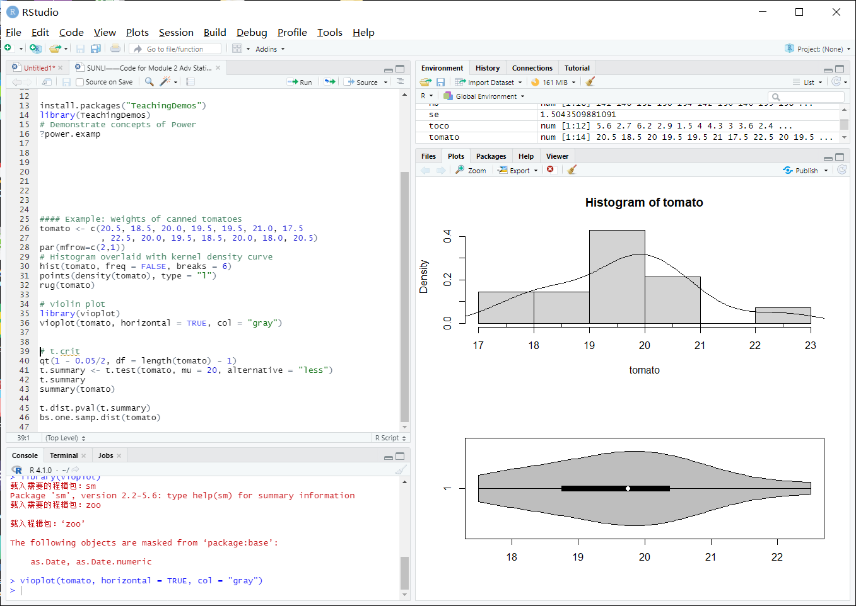

Slide 3
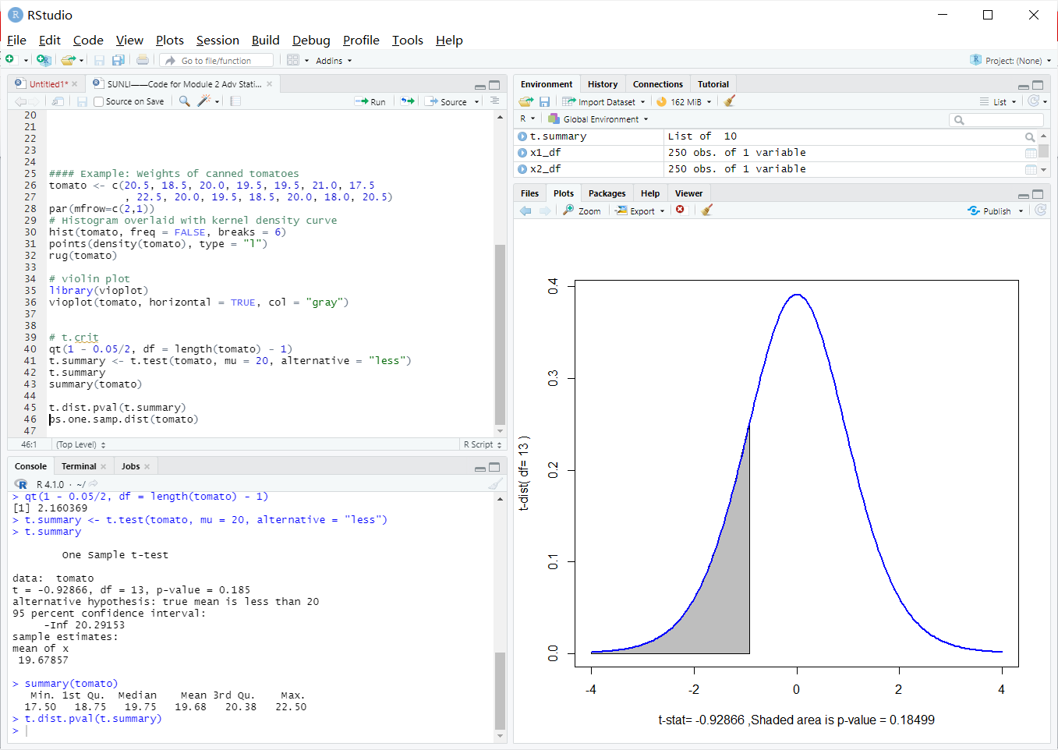

Slide 4
